Slide 1
PI-23 Community Meeting
Simeon Oriko
Director of Community

Slide 2
Welcome to our special guests and community members!
Paula Hunter
Executive Director

Slide 3
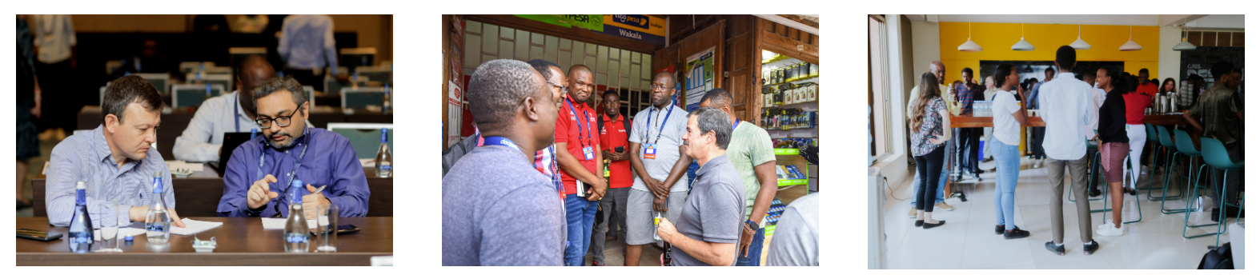
Our mission: increase financial inclusion by empowering organizations creating interoperable payments systems to enable digital financial services for all.
The support and contributions from our community are critical to achieving this mission!

Slide 4
Mojaloop Foundation Priorities
Focus on Mission: Financial Inclusion
Deployments
Product Alignment to Market Requirements
Partnerships to ensure successful deployments and organizational sustainability

Slide 5
Objectives for this week
Learn
Meet
Get Updates
Review
Celebrate
Plan
Central Banks and Hub Operators
New Community Members & Mojaloop Foundation Staff
Workstreams
Product Roadmap
Community Contributions
PI-24, March 2024, Nairobi Kenya

Slide 6
Mojaloop Foundation Corporate Structure and Governance
Governance
Staff
Outsourced Staff
Legal Structure
Non-profit corporation
All work offered for Public Good
Open Source licenses for all code
Operations and staff funded by grants and membership dues
No income derived from software or services
Councils
Paula Hunter
CEO / Executive Director
Chair
Board of Directors
Secretary
Treasurer
Technical Governing Board
Design Authority
Change Control Board

Slide 7
Organization
Governance
Paula Hunter
CEO / Executive Director
Andy Widmann
Deputy Director
James Bush
Engineering Director
Steve Haley
Director of Market Dev & Partnerships
Simeon Oriko
Director of Community
Sam Kummary
Technical Director
Paul Makin
Product Management
Desire Kachenje
Manager of Grants & Partnerships
Dawn Pereira
Singapore Operations Manager
Product Council
Megan Cannon
Community Operations Manager
Victor Malu
Sr. Business Development Lead
Megan Skinner
Community Operations Support
Peter Houston
Training Support
Community Council
Olivier Manzi
Technical Project Lead
HQ Team
Peter Houston
Board & TGB Secretariat
Events
Finance
Marketing
PR
Staff
Outsourced Staff
Councils

Slide 8

For your consideration: Open Source Report
Key Topics:
Consuming Open Source Software
Managing potential risks related to Open Source usage
Contributing to Third-Party Open Source Projects
Available online at:
https://www.finos.org/hubfs/whitepapers/FINOS-business-value-of-open-source.pdf

Slide 9



Planning for 2024 – Top Priorities
Delivering Proof of Concepts and launching new Implementation Projects
Updating our Roadmap, Product Documentation, and Training
Release Planning and Execution
Increase Community Engagement and Partnerships

Slide 10
Welcome
Steve Haley
Director of Market Development and Partnerships

Slide 11
Priority Pillars
Make Adoption Easier
Achieve Scale
Connect to other systems
Quality Product

Slide 12
Introduction
Akinwale Goodluck
Deputy CEO
AfricaNenda

Slide 13
Introduction
Teddy Soobramanien
CEO
COMESA Business Council

Slide 14
Keynote
Kabwita Kabwita
Operations Manager
Zambia Electronic Clearing House (ZECHL)

